Slide 1

ChatSonic
Group 9:
Abdulrahman Almyman–
Waleed Alnajashi–

Slide 2

Introduction
What is ChatSonic ?
ChatSonic is an AI-powered chatbot platform from Writesonic that simplifies communication boosts productivity and helps you stay organized like ChatGPT.

Slide 3

Company and founders
Writesonic is an AI-powered writing assistant platform founded by Samanyou Garg in oct 2020 In January 2021, Writesonic launched its AI Article/Blog Writer, which generated a full-length article with the input of a few words. This feature became the most popular and was named "Best AI writer of 2021" by TechRadar. The award has since been extended to "Best AI writer of 2022." .

Slide 4
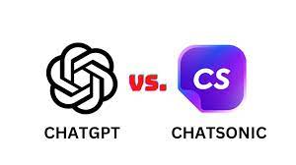
ChatSonic vs ChatGpt :
ChatGPT is restricted by the inputs or training data (up till 2021) that cannot be updated as regularly. On the other hand, Chatsonic is a more advanced and powerful version that can keep up with current news and events, granting it an advantage in terms of precision and dependability.[1]

Slide 5
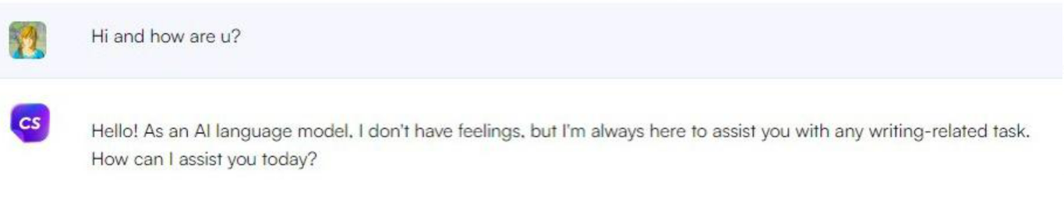
Testing the product

Slide 6
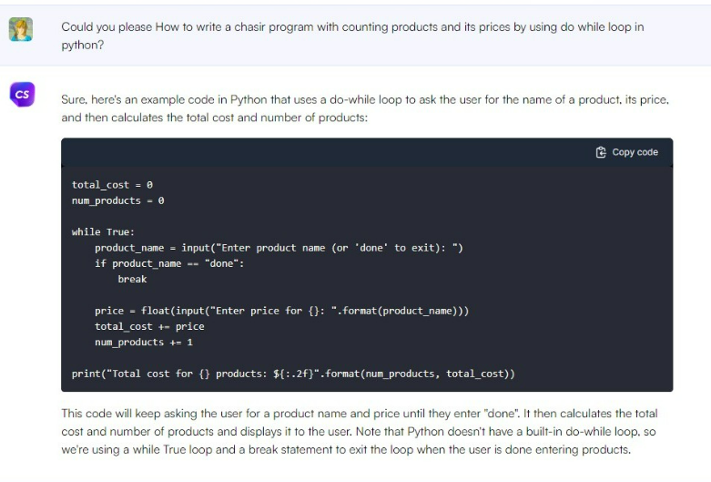
Testing the product:

Slide 7
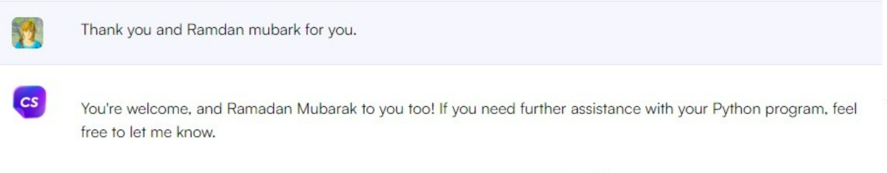
Testing the product:

Slide 8

The technical principle of Chatsonic:
The Technical Principle of Chatsonic: is powered by a sophisticated machine learning model based on neural networks which enables it to simulate human speech. It has integration with Stable Diffusion and DALL-E for image generation, and a powerful connection with Google search that helps to come up with hyper-relevant content. ChatSonic uses natural language processing technology to answer your questions accurately and informatively.

Slide 9

Competing products:
ChatGPT: ChatGPT is a popular AI writing tool that uses deep learning to generate natural language text .
OpenAI Playground: OpenAI Playground is an open-source platform that allows developers to build and train AI models.
Google's Bard: Google's Bard is an AI language model that can write poetry.

Slide 10

Revenue (2021):
In 2021 Chatsonic generated $1M in revenue.

Slide 11
Revenue (2022-2025):
Chatsonic is expected to generate $1M – $2M in 2025

Slide 12
References:
Samanyou Garg - Founder and CEO - Writesonic (YC S21)
Samanyou Garg - Founder and CEO @ Writesonic
About Writesonic | We Help You Scale Content Production
https://writesonic.com/compare/chatsonic-vs-chatgpt

Slide 13
Thank you for listening
Abdulrahman Almyman
Waleed Alnajashi

